Slide 1
Retrieval Practice
Mrs E Sperring

Slide 2
Retrieval Practice – The Theory
Retrieval Practice isn’t a new idea
It refers to the act of recalling information that has been learned, from memory, with little or no support.
Every time the information is retrieved, or an answer generated, it changes the original memory to make it stronger and stores it in the long term memory.
This means it is easier to retrieve in the future.
When we come across something new, the information is stored for a very short time in our short – term memory.
If we rehearse and retain information then it becomes stored in our long term memory and the more we retrieve it, the easier it becomes to remember.

Slide 3
Retrieval Practice – How and Why We Use It
We use ‘Retrieval Practice’ in the classroom to help retain information, but also to identify any ‘gaps’ that might exist in a students knowledge
Testing students on the knowledge that they have retained, helps them to organise their knowledge in a more organised way.
It can also improve how well a student can transfer knowledge to new problems and retrieve information that hasn’t been tested.
Retrieval Practice should be used constantly when it comes to revision, not only when exams are coming up, but also after lessons, to encourage the brain to retain what it has seen.
Retrieval Practice is suited to different scenarios
This should occur on a very regular basis
If a student is confident with their knowledge and can easily retrieve it without referring to notes or revision guides then it doesn’t need as much practice.

Slide 4
Examples of Retrieval Practice

Slide 5
Knowledge Organisers

Slide 6
Challenge Grids

Slide 7
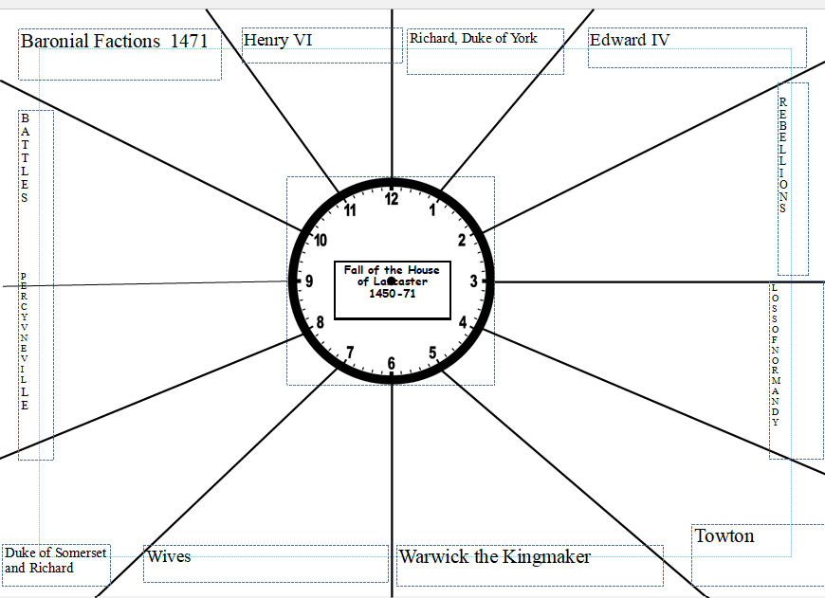
Revision Clocks

Slide 8
Flash Cards

Slide 9
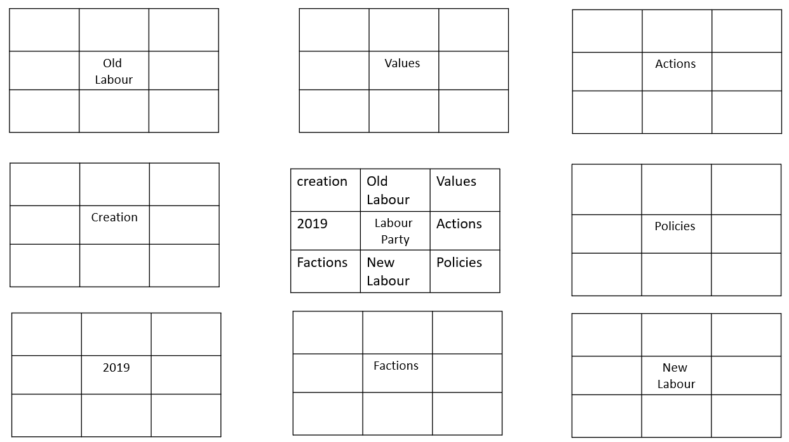
Lotus Grid

Slide 10
Dual Coding

Slide 11
Mind Maps

Slide 12
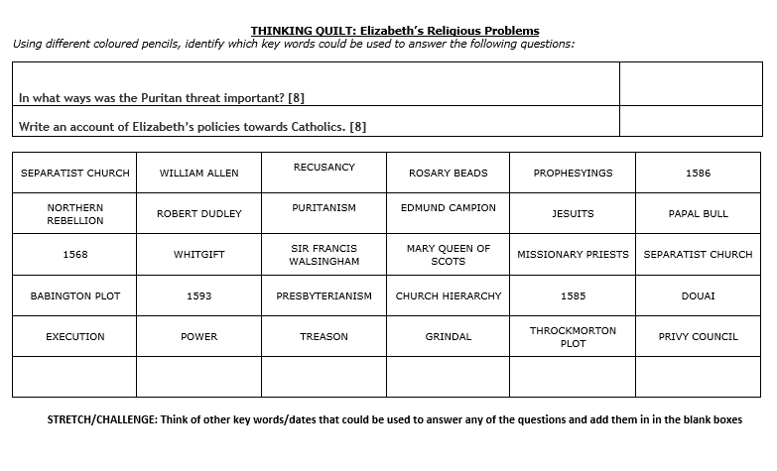
Thinking Quilts

Slide 13
Has It Stuck?

Slide 14
In Summary
Retrieval Practice is all about making the knowledge ‘stick’ and using a variety of methods to help it stay in your long term memory.
It is not advisable to revise all topics in one go or ‘large blocks’
It is more effective to revise small chunks for 15 minutes or so and then move onto another chunk of a different topic.
This helps improve your long term memory.
Retrieval Practice is most successful when you think of it in 3 stages:
The Bigger Picture – Looking at a whole topic or unit and producing something like a mind map or revision clock with key information.
Break that down and focus on the key elements in term and create revision flashcards and/or post it notes
Use those flash cards for self quizzing or getting someone to quiz you. If you successfully retrieve the information you need, you know you don’t need to revisit it immediately and if you struggle, you know you need to practise that element further.

