Slide 1
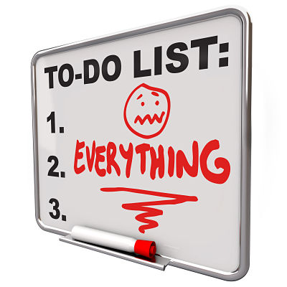
How to be a successful 6th former. A quick guide.
(Or how to have a less stressful
experience)

Slide 2
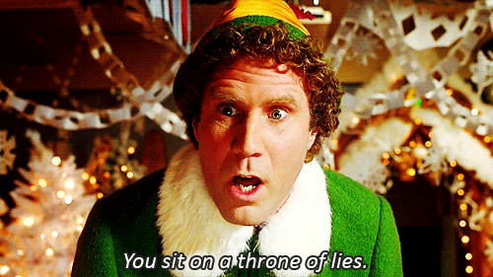
Notes:
A ‘year’ is mis-leading. Students are about to find out the reality.

Slide 3
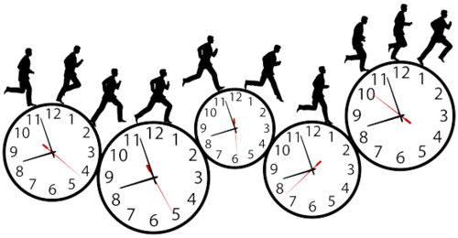
16 weeks
10 weeks
6 weeks
Notes:
This is how the 3 terms break down. The blue line indicates that by Christmas, you are close to half way through the year before the exams start.

Slide 4
Nov.
Oct.
Sept.
Notes:
Warn students about not getting complacent early on – things can seem reasonably unstressed as you are eased into courses. But this picture quickly changes. By Xmas, many students are feeling very stressed. Prepare for this.

Slide 5
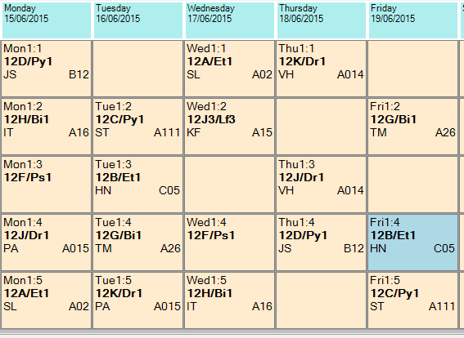
Private
Study
Private Study
Notes:
Free periods! Not FREE at all. An important change in the student’s daily life but they are there for a reason …

Slide 6
I believe they’re
called ‘frees’, Miss.

Slide 7
Private
Study
Area
Common
Room
Notes:
Think about how/where to spend your time. I stressed that there SHOULD be opportunities during the week where students can simply socialise. But it’s about balance. Parents shouldn’t be hoodwinked by their youngsters claiming they ‘do all their work’ at school ….

Slide 8
Big Picture Planning
Going out
D of E
Job
College
course
Choir/
Orchestra
Deadlines
6th Form
Management
Work
Experience
Revision
Charity event
Gym
College
production
Cadets
Sports Team
Notes:
It should be a busy year. Thriving students often have a lot of things on the go. School work has to be a top priority – but it’s important to get involved with different activiites – especially if you have never done much before. PLANNING is essential.

Slide 9
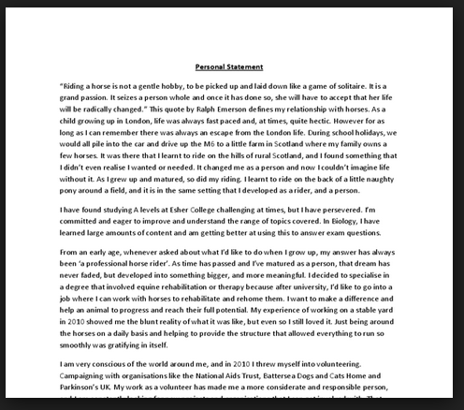
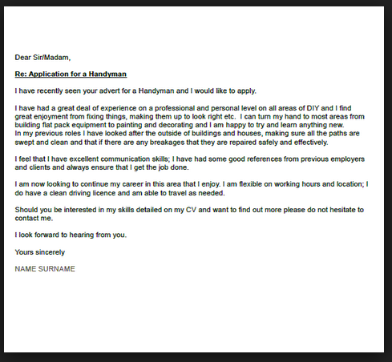
Organising for later on
Notes:
I always tell the story of how twice in my career I encountered Sixth Formers who literally had NOTHING to put in their personal statements. Even ‘helping with hampers’ was a white lie. So to students who haven’t been involved with much so far – this is the time to make a change, either in College or out.

Slide 10
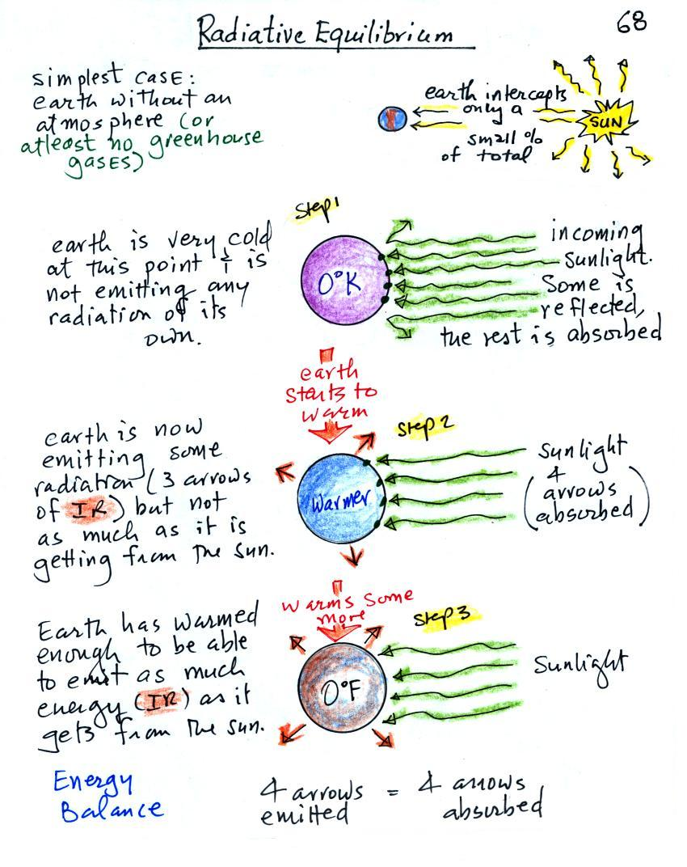
Making notes
Notes:
Notes are essential. And what gets scribbled down in the lesson is simply the START. Outside of lessons, notes need to be written up, developed, reorganised, filed away. (I usually show some examples from my own good students at this point)

Slide 11
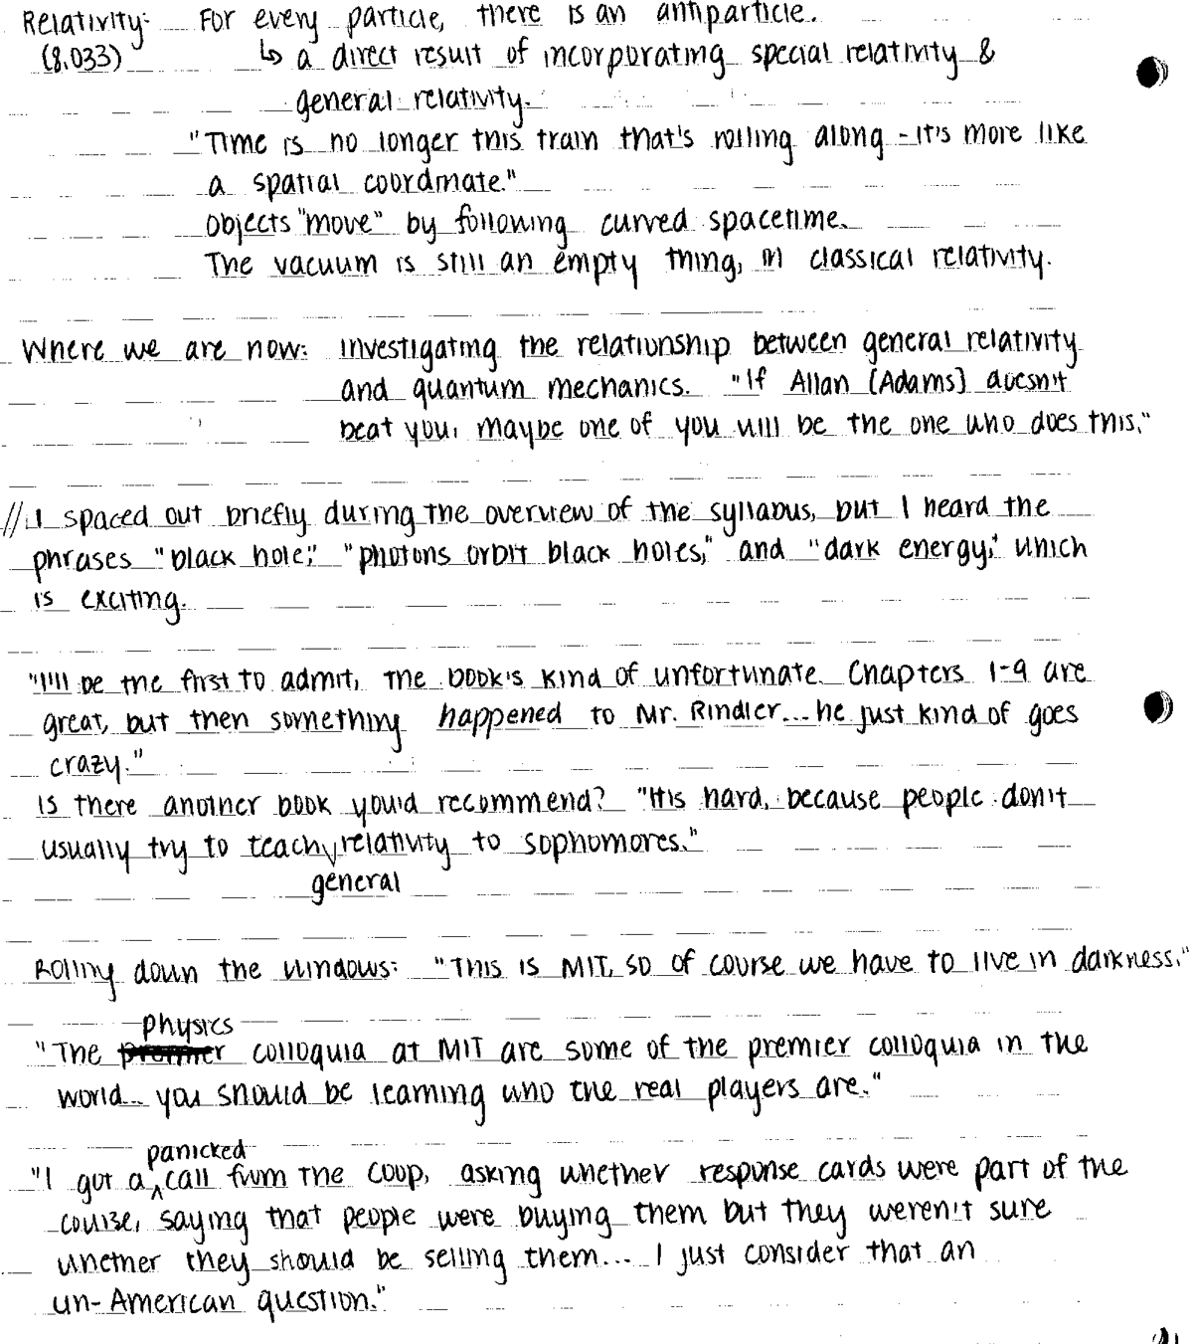
Making notes

Slide 12
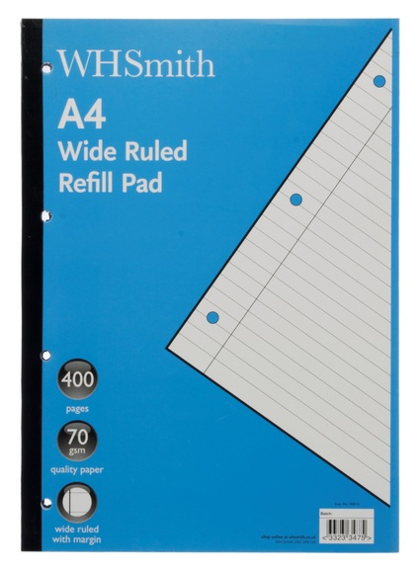
Equipment
Notes:
Organising notes. Often students aren’t even told that they now have to buy their own equipment.

Slide 13
Question:
What’s the worst thing an A level student can say to a teacher?

Slide 14
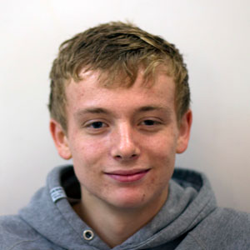
I’ve got nothing to do.
I’ve done all my work.
Notes:
You have NEVER EVER finished all the work that needs doing. Parents should be wary of a child who says they have. If a student thinks they have ‘done everything’, then they don’t really understand what A level is all about.

Slide 15
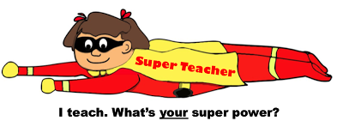
What about when I get stuck or stressed?

Slide 16
Email
Hi Sir,
Is it possible you can go over the notes……
Dear Miss,
I just wondered if you could send me…..
Hey Miss,
I didn’t quite get the…….
This may be a good time to think about your email address!!
MrPengTing9xoxo@gmail.com
When you arrive you will be given a Wigston College student email address.
Notes:
The changing relationship with your teachers. Communication outside of the lesson becomes increasingly important. Many students may never have emailed a teacher – that changes in the 6th Form. And if they still have a ‘hilarious’ email address that they got in Year 9, now might a good time to change it by opening a new Gmail account (free). They will need it for job/uni applications later.

Slide 17
Transition Packs
Notes:
Handed out at the end of the Summer Term and due in soon/already?

Slide 18
Good luck,
everyone!

